Slide 1


DIWALI SALES
Presented by Rahul Rajput
Project link : https://colab.research.google.com/drive/1ew9fpvfeO0x0XTNESGlICZXCnuEwswWL?usp=sharing
Dataset link : https://www.kaggle.com/datasets/saadharoon27/diwali-sales-dataset

Slide 2

INTRODUCTION
The Diwali Sales project aims to analyze sales data from a retail or e-commerce platform to uncover customer purchasing behaviors during the Diwali season. The primary focus is on identifying key sales trends, popular product categories, and customer demographics that drive revenue.

Slide 3

PROJECT OBJECTIVE
To understand purchasing patterns and customer demographics influencing Diwali sales.To identify high-performing products and categories.To derive actionable insights that can boost future Diwali sales and optimize marketing strategies.

Slide 4
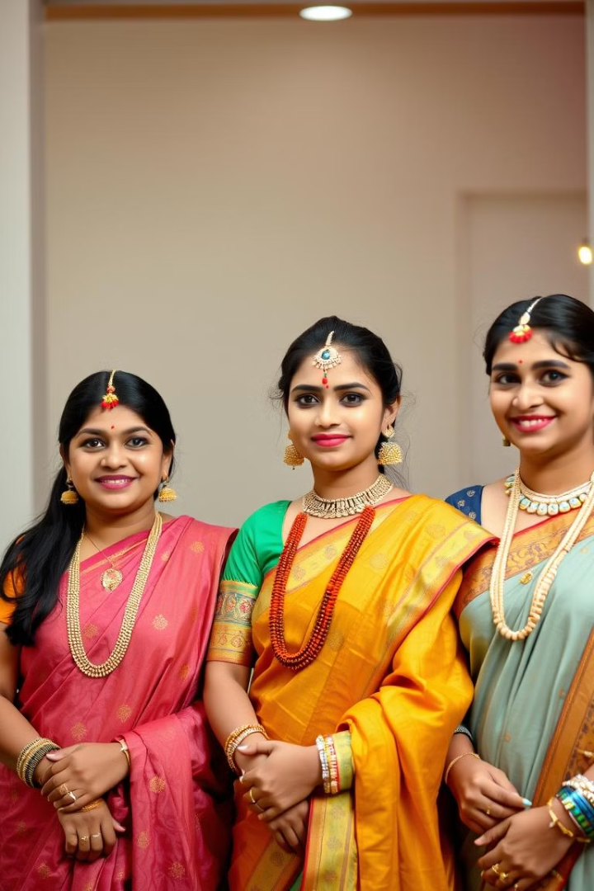
STEPS TAKEN IN THE PROJECT
Data Collection: Sales data was gathered, including customer information, product details, and transaction history.
Data Cleaning: Handled missing data, corrected data types, and removed inconsistencies.
Exploratory Data Analysis (EDA): Analyzed sales trends, product performance, and customer segmentation.
Visualization: Created charts and graphs to visually represent insights for better understanding.
Modeling (if applicable): Used machine learning or statistical techniques to predict or classify outcomes.

Slide 5
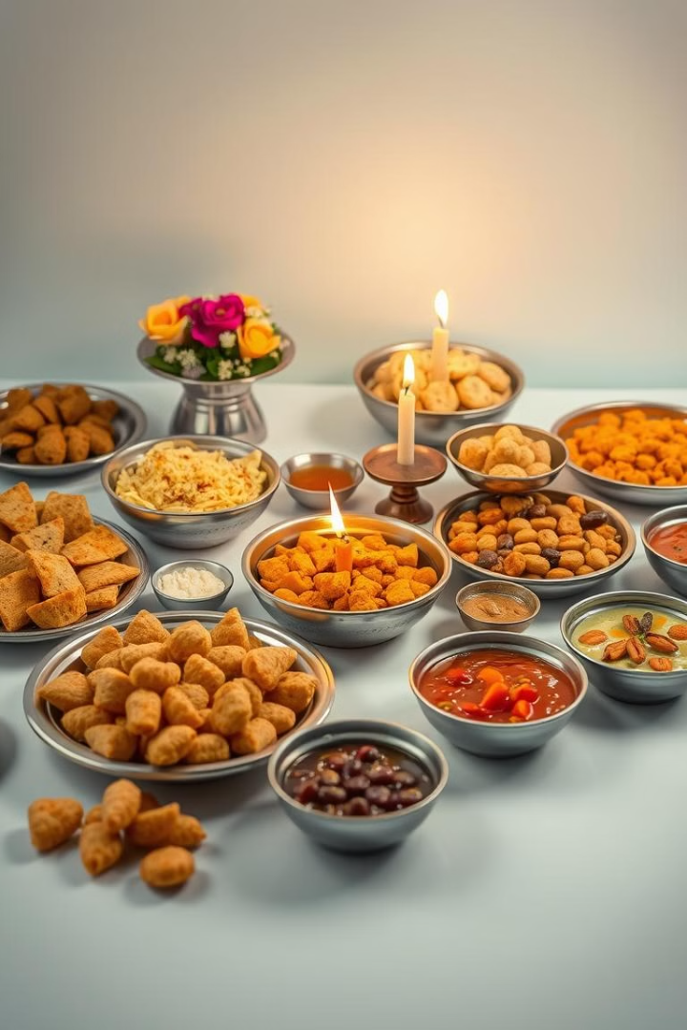
INSIGHT AND FINDINGS
High Sales Period: Sales peaked during specific days leading up to Diwali.
Popular Products: Categories like electronics, apparel, and home decor saw significant spikes.
Customer Demographics: The majority of high-value purchases were made by customers aged 25-40.
Sales Channels: Online platforms outperformed physical stores in terms of sales volume.

Slide 6
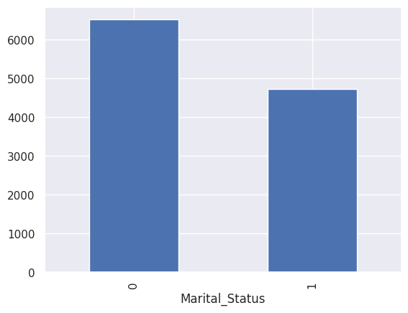
Distribution of Marital Status Among Customers
The bar chart illustrates the distribution of marital status among customers. The majority of customers, represented by 6000 individuals, are unmarried (Marital_Status = 0). In contrast, a smaller group of 4700 customers are married (Marital_Status = 1). This indicates that unmarried individuals constitute a larger segment of the customer base.

Slide 7
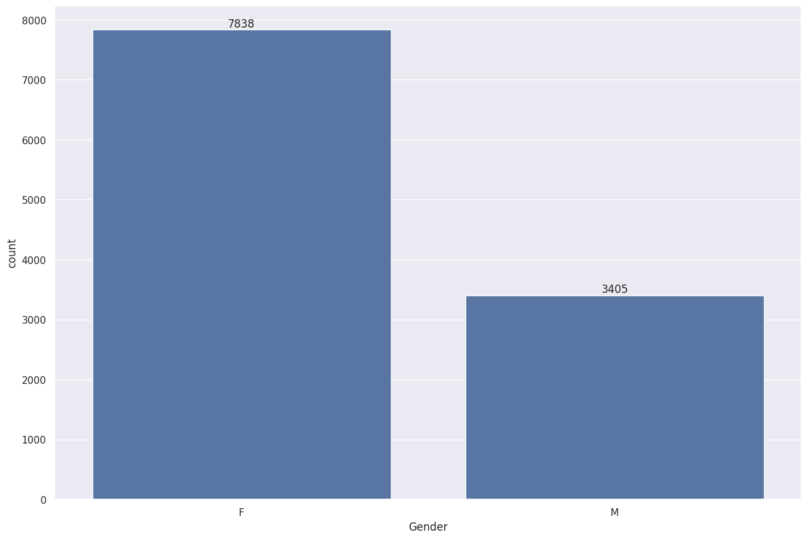
Gender Distribution of Customers
The bar chart presents the gender distribution of customers. The data reveals that female customers significantly outnumber male customers. Specifically, there are 7838 female customers compared to 3405 male customers, indicating a clear gender imbalance within the customer base.

Slide 8
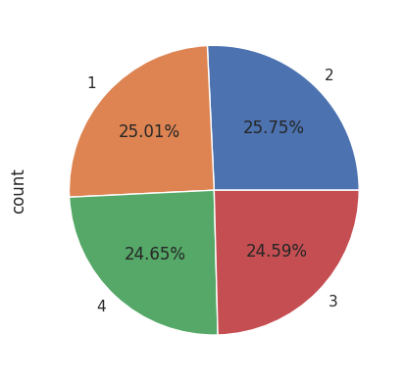
Frequency Distribution of Orders
The pie chart illustrates the frequency distribution of orders. The categories 2 and 1 have the highest frequencies, each accounting for approximately 25.75% and 25.01% of the total orders, respectively. Categories 4 and 3 follow with 24.65% and 24.59%, respectively, indicating a relatively even distribution among the four categories.

Slide 9
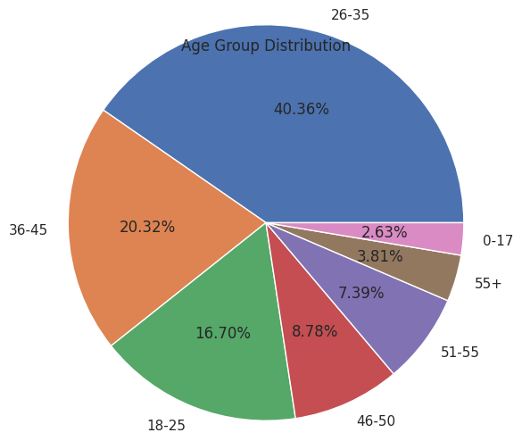
Age Group Distribution
The pie chart shows the distribution of individuals across different age groups. The largest segment belongs to the 26-35 age group, comprising 40.36% of the total. Following this, the 36-45 age group accounts for 20.32%, and the 18-25 age group represents 16.70%. The remaining age groups, including 46-50, 51-55, 55+, and 0-17, have smaller proportions, ranging from 2.63% to 8.78%.

Slide 10


CONCLUSION
The project provides valuable insights into optimizing future Diwali sales strategies by focusing on high-demand product categories and targeting key demographics. Recommendations include enhancing inventory for trending products, running targeted marketing campaigns, and leveraging online platforms for greater reach.

Slide 11

THANK YOU

